Slide 1

Department of Computer Science & Engineering
StellarStudent
Date: 10th May 2021
Tarani Talluri : 17wh1a0576
Raga Rasagna P : 17wh1a0599
Pravallika M.N : 18wh5a0517
Internal Guide: Dr. N. Sreekanth
Designation: Associate Professor
BVRIT HYDERABAD College of Engineering for Women

Slide 2
Abstract
StellarStudent is a social networking web application for colleges. It helps to connect both students and faculty. It refers to the outstanding students, and showcases the ones better than everyone else. Stellar is a word of praise or excitement and StellarStudent aims to praise the best performed students by their performances tracked through the application. Any student who puts the time and effort into their courses is a stellar student. The project involves developing a website where complete details of the students are recorded such as their academic non academic achievements. They can upload their certificates and the faculty can view them. Students can also view the materials uploaded by the faculty, view attendance, grades and participate in quizzes. This application is also helpful to know various events/activities happening in the college through notifications. Students and faculty can view latest updates and timelines, this application also supports various meetings and discussions.
BVRIT HYDERABAD College of Engineering for Women

Slide 3
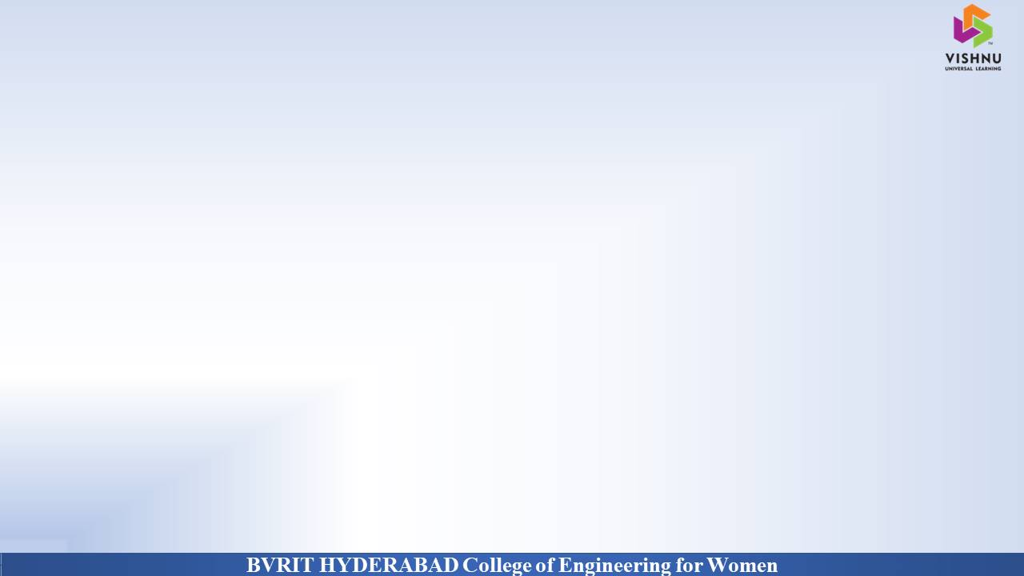
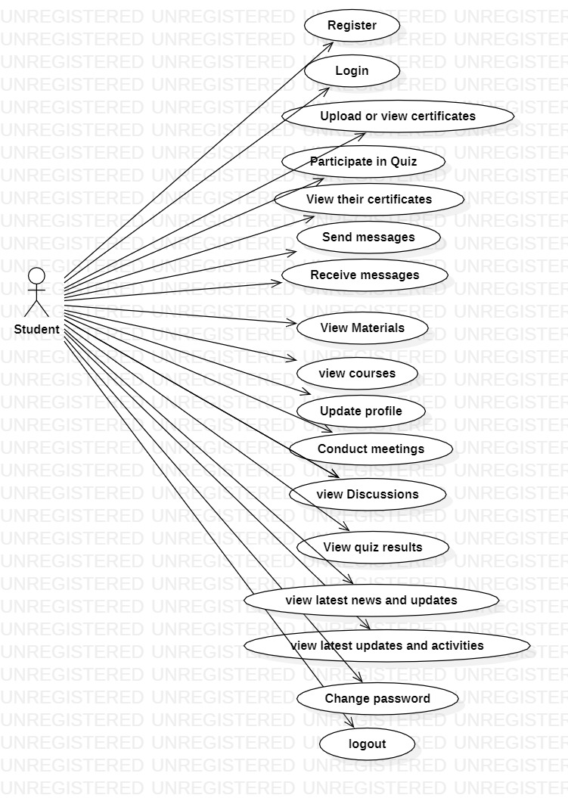
Why Should I Study this course?
StellarStudent :: Use Case Diagram for Student
Examples
BVRIT HYDERABAD College of Engineering for Women

Slide 4
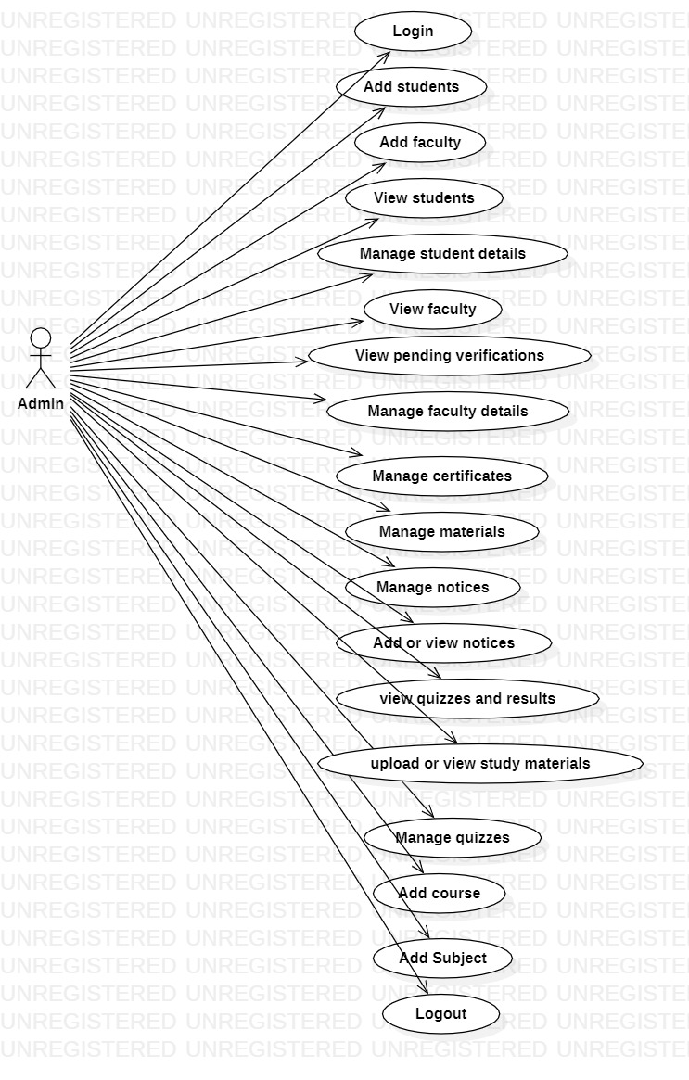
Why Should I Study this course?
StellarStudent :: Use Case Diagram for Admin
Examples
BVRIT HYDERABAD College of Engineering for Women

Slide 5
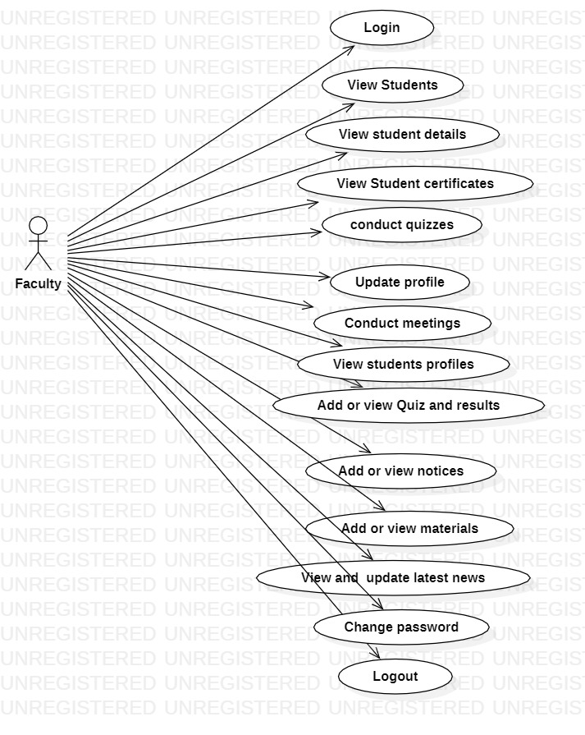
Why Should I Study this course?
StellarStudent :: Use Case Diagram for Faculty
Examples
BVRIT HYDERABAD College of Engineering for Women

Slide 6
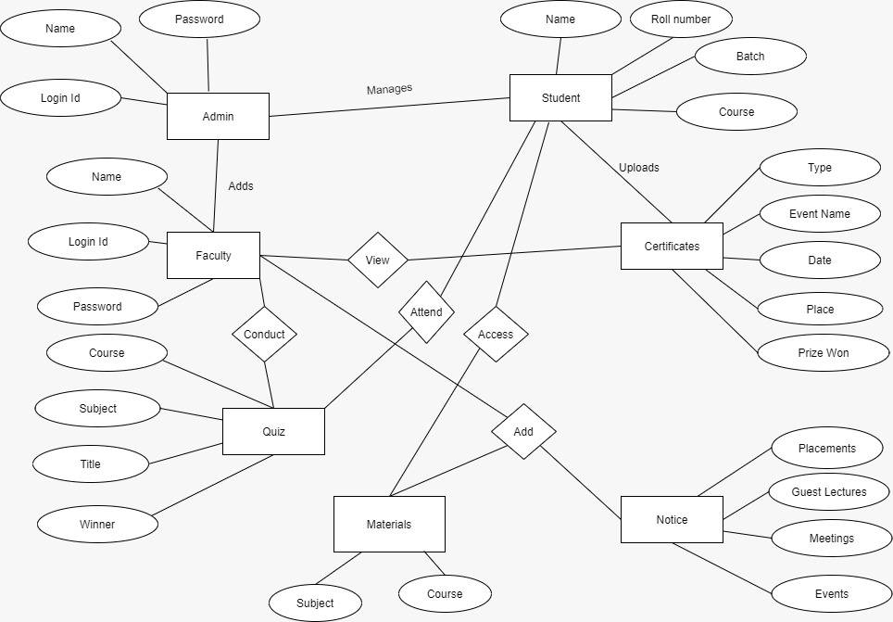
ER Diagram
BVRIT HYDERABAD College of Engineering for Women

Slide 7
Tools and Technologies
Environment | Specification
Hardware | Processor - Intel Core i3 OS: Windows 8 and above Memory(RAM) - 4 GB Storage – 50 GB or more
Software | XAMPP 1.8.2 Sublime Text 3 MYSQL Server 5.4 StarUML Browser: Microsoft Edge, Google Chrome, Mozilla Firefox
BVRIT HYDERABAD College of Engineering for Women

Slide 8
Thank You
BVRIT HYDERABAD College of Engineering for Women

